Slide 1
Design of Composite Bridge
G.V.S.Sri Ram,
15CE31015

Slide 2
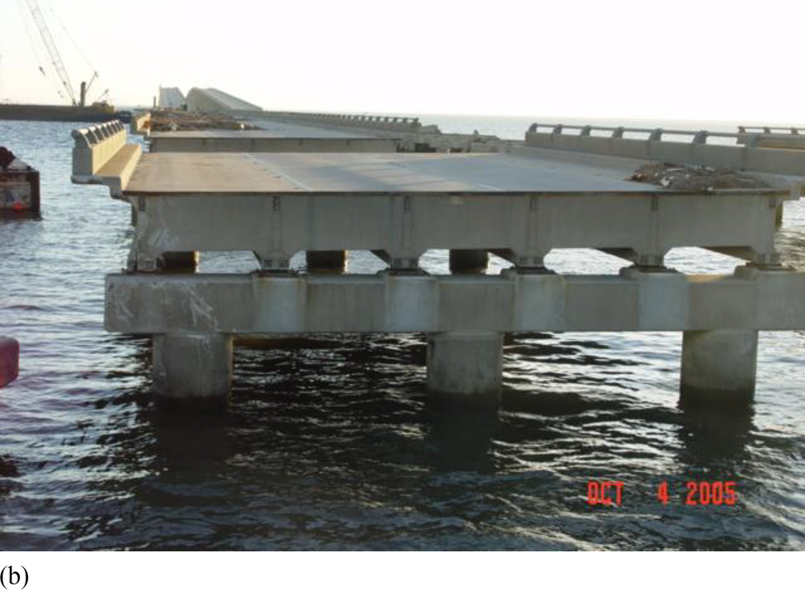
Objective
The objective is to design individual steel girders for the various spans and model the composite bridge using these steel girders

Slide 3
Scope of work
Designing of steel (I section) girders for different spans
3D Finite Element Abaqus Model of bridge using Python Programming

Slide 4
Methodology for Design of Plate Girders
Assumption-1 :Bending moment will be resisted by the flanges
Assumption-2 :Shear will be resisted by web
Fe410 grade of steel:
f_{u} = 410 MPa E = 2 × 10⁵ MPa
f_{y} = 250 MPa μ = 0.3

Slide 5
Design of Web with no stiffeners:
d/t_{w} < 200 from serviceability criteria
< 345 from flange buckling criteria
Assume suitable k = d/tw,
Optimum depth of plate girder, d = (M_{z}k/f_{y})^{0.33}
Optimum web thickness, tw = (M_{z}/f_{y}k²)^{0.33}
Required area of flange, A_{f} = (M_{z}𝛄_{m0})/(f_{y}d)
Width of flange = 0.3*d

Slide 6
Two steel girders are placed 2m apart
Load on it is due to concrete deck, self weight and IRC 70R
Bending Moment is due to the load acting on it

Slide 7
Case-1: Partial Load case
One track is directly on top of the girder and another track is located at a distance away from it.
In this case, load from the track directly above is transferred 100% to the girder
load from another is partly transferred i.e 0.5P*(b-a)/b, where a is the distance of the second track from girder and b is spacing between two girders.

Slide 8
Case-2: Full Load case
In this case, we are considering the situation where two tracks are on either side of the girder.
In this case, load from both of the tracks are transferred 100% to the girder and thus load acting is 0.5P+0.5P = P

Slide 9
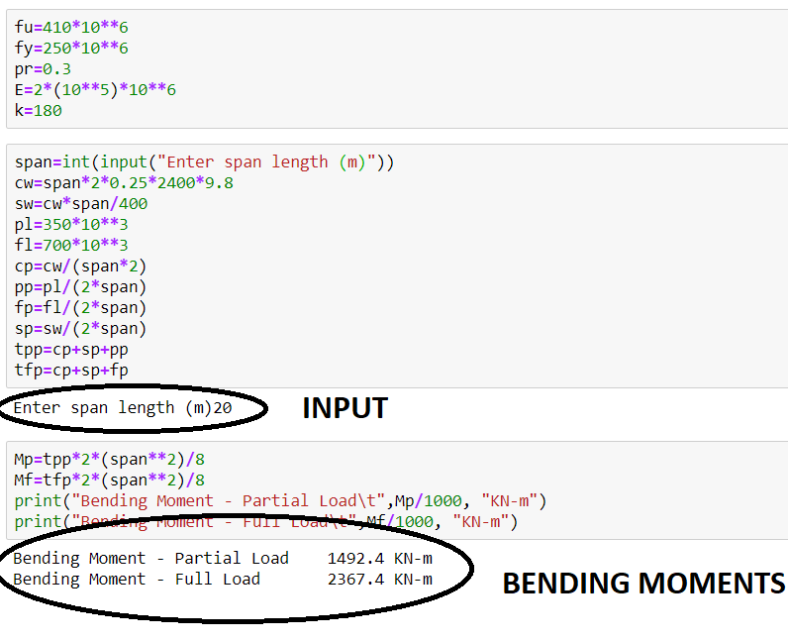

Slide 10
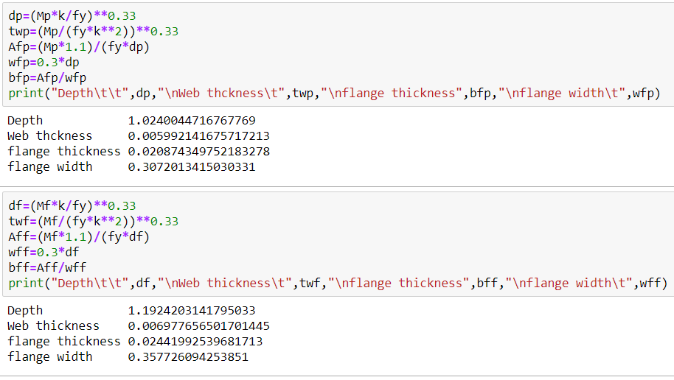
PARTIAL LOAD CASE
FULL LOAD CASE

Slide 11
Maximum Bending Moment on Steel Girder
Span (m) | Partial Load ( KN-m ) | Full Load ( KN-m )
10 | 588.175 | 1025.675
20 | 1492.400 | 2367.400
30 | 2734.725 | 4047.225
40 | 4337.200 | 6087.200
50 | 6321.875 | 8509.375
60 | 8710.800 | 11335.800
70 | 11526.025 | 14588.525
80 | 14789.600 | 18289.600

Slide 12
Allowable Stress: 120 Mpa
Span(m) | Depth (mm) | Web thickness (mm) | Flange thickness (mm) | Flange width (mm) | Partial Load (MPa) | Full Load (MPa) | Weight (Kg/m)
10 | 600 | 12 | 20.8 | 210 | 59.6 | 74 | 120
20 | 1000 | 16 | 30 | 250 | 77.6 | 97.6 | 234
30 | 1500 | 20 | 36 | 300 | 73.4 | 94.2 | 390
40 | 2250 | 25 | 40 | 300 | 71.5 | 83.5 | 610
50 | 2750 | 32 | 50 | 360 | 88 | 99.7 | 942
60 | 3500 | 40 | 60 | 400 | 84.7 | 90 | 1429
70 | 4000 | 55 | 75 | 400 | 83.2 | 91.4 | 2178
80 | 4500 | 70 | 100 | 500 | 85.3 | 93 | 3128

Slide 13
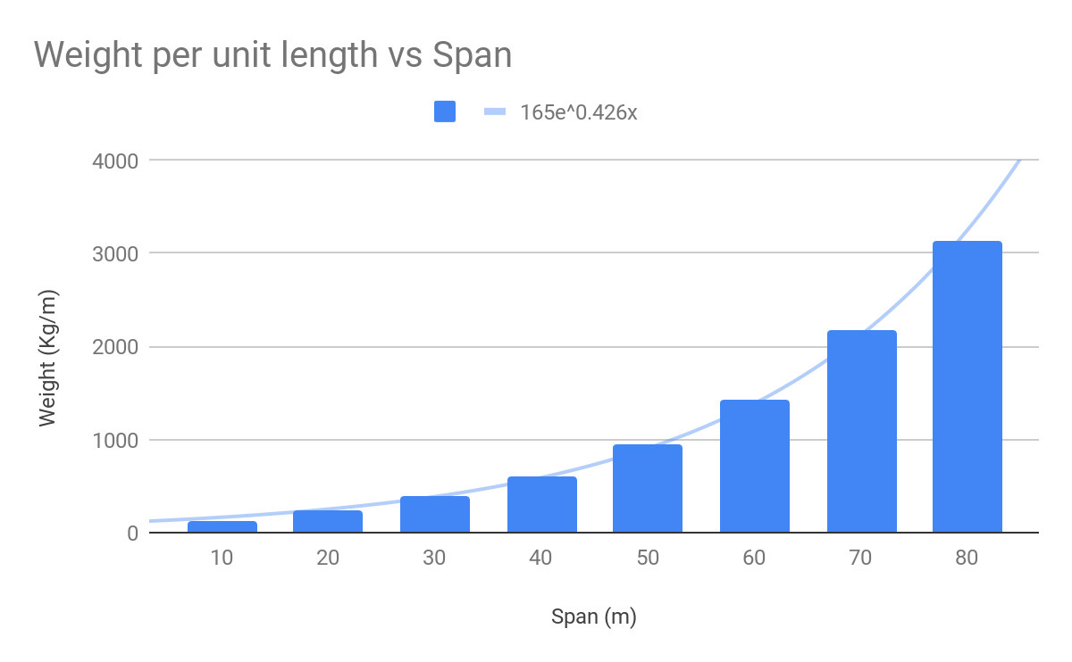
This exponential variation between Weight and span lengths can be useful to provide cost estimation at the early stages of project

Slide 14
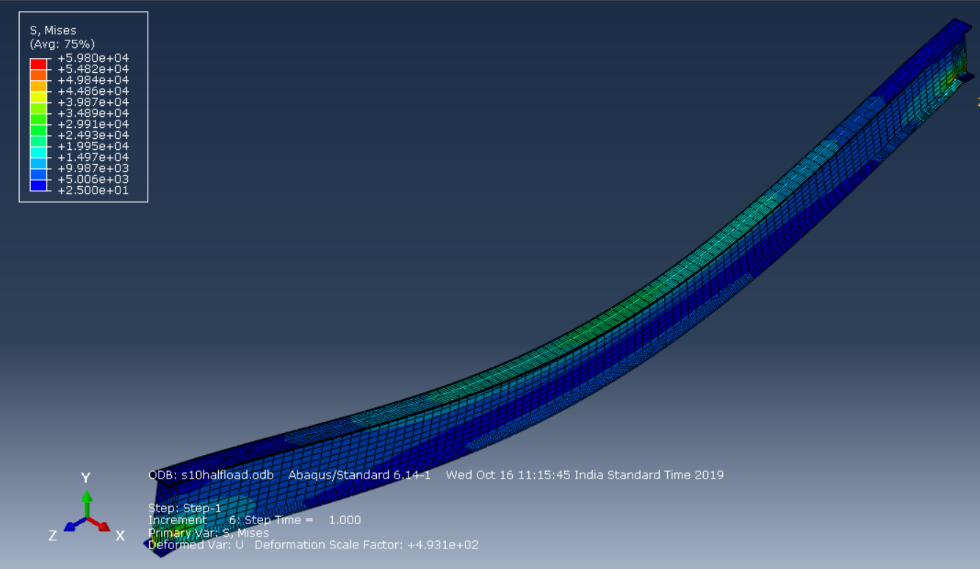
Span : 10m, partial load

Slide 15
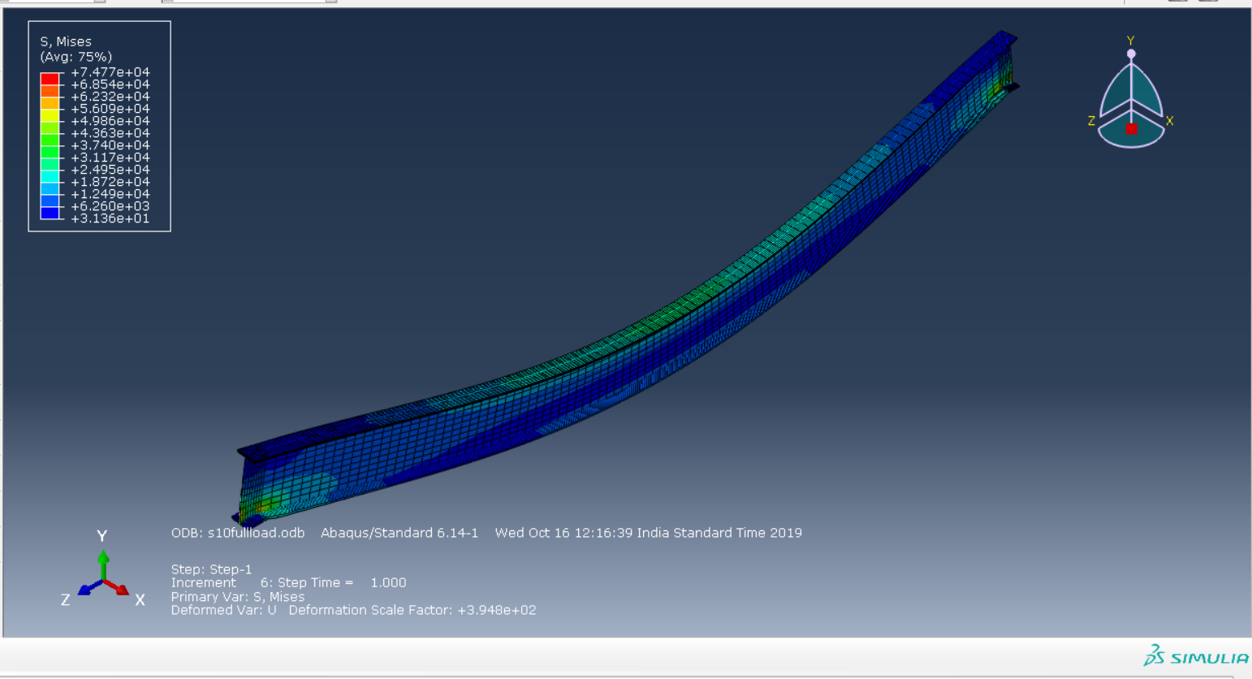
Span : 10m, full load

Slide 16
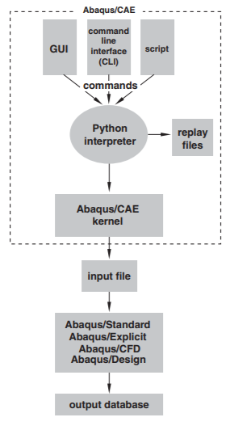
Finite Element Model using Python

Slide 17
Input:
Span Length and width of deck
Expected Output:
A script containing complete 3D Finite Element Model in Abaqus
Current Progress:
Creates a concrete deck part automatically

Slide 18
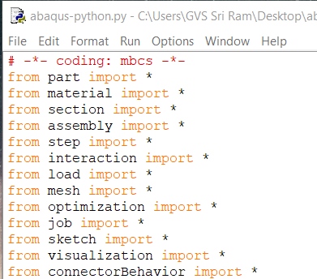
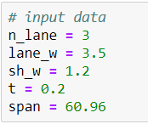

Slide 19
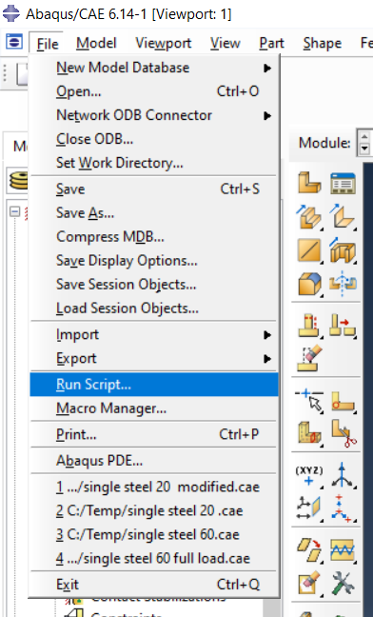
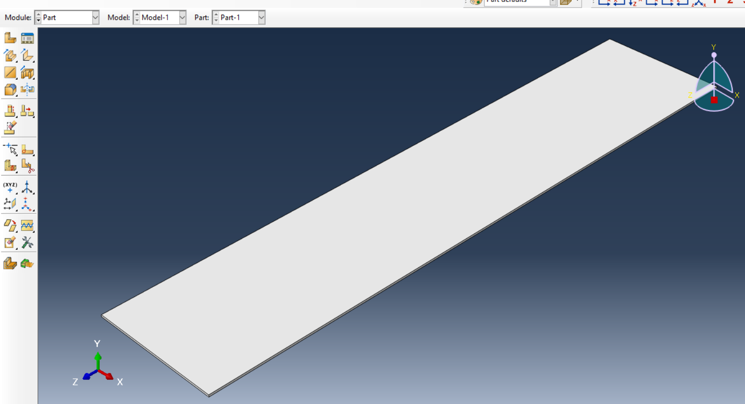

Slide 20
Future Works
Generating Finite Element Model

Slide 21
Conclusion
Now we have the specifications of the plate girders for various spans and we use them to model the 3D Abaqus model of composite bridge using Python Programming

